Slide 1

CE101 Engineering Drawing Lec6: Projection of Solids
Indian Institute of Technology Guwahati
Notes:
Today we will discuss about the Modeling and

Slide 3
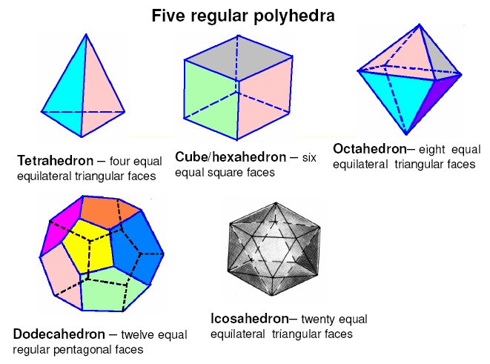

Slide 4
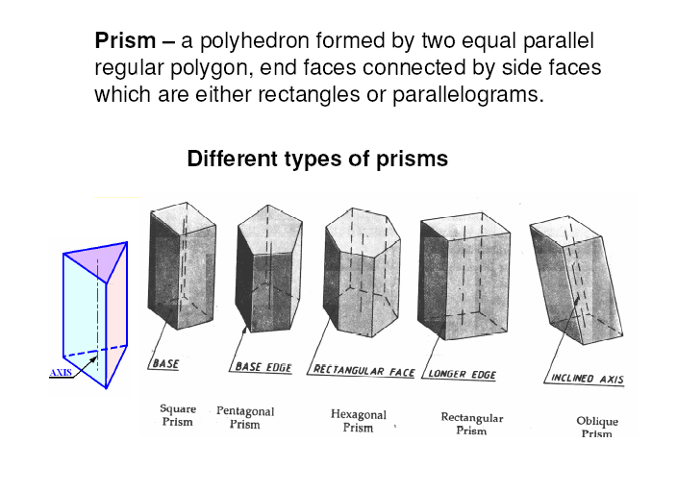

Slide 5
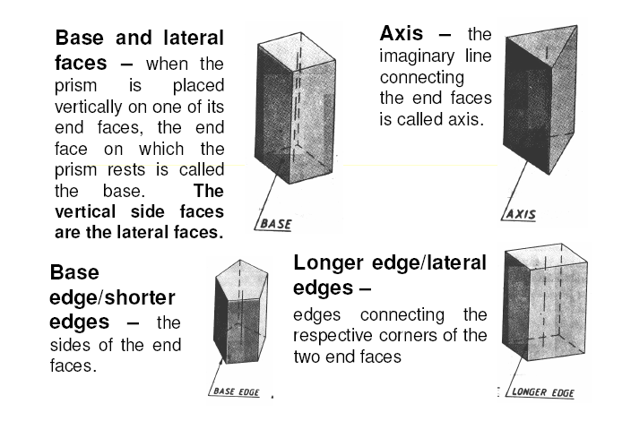

Slide 6
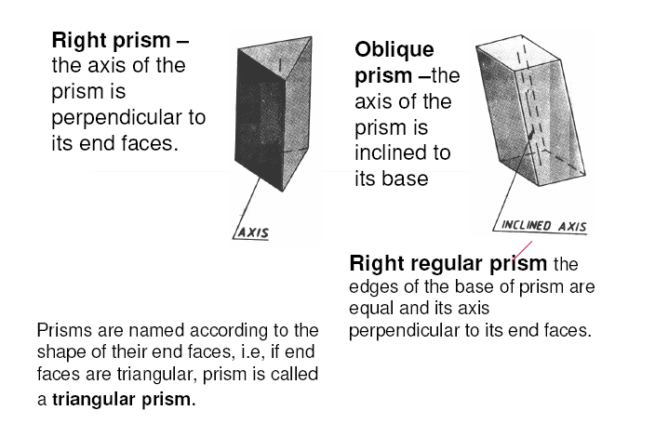

Slide 7
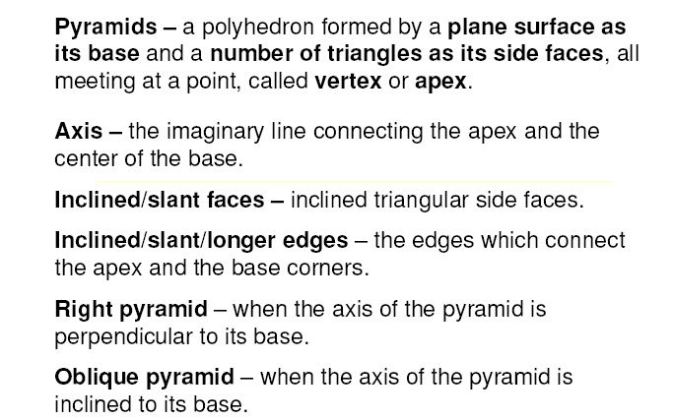

Slide 8
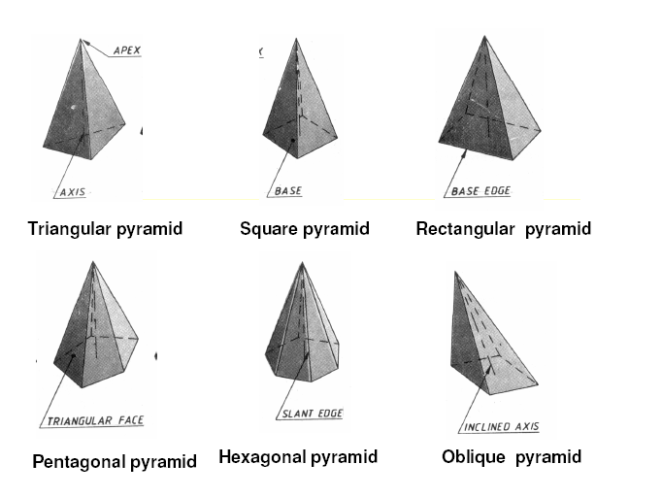

Slide 9
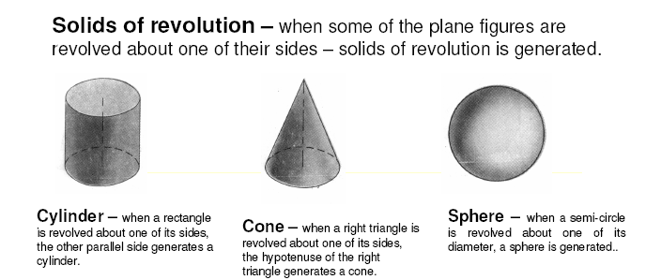

Slide 10
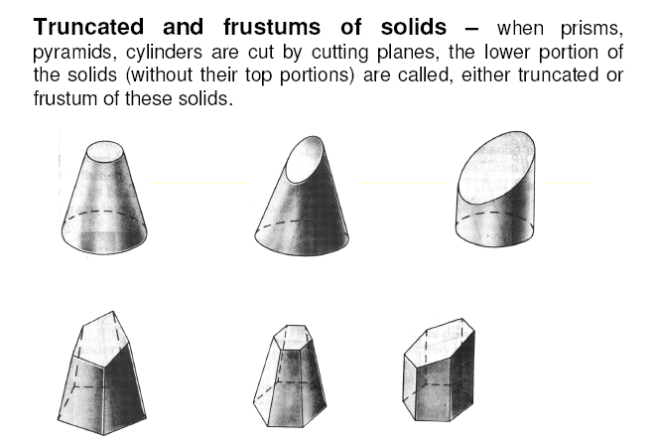

Slide 11
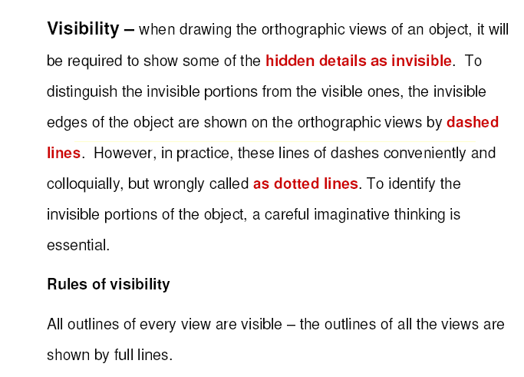

Slide 12
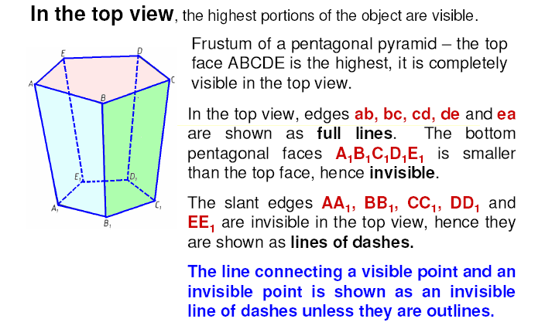

Slide 13
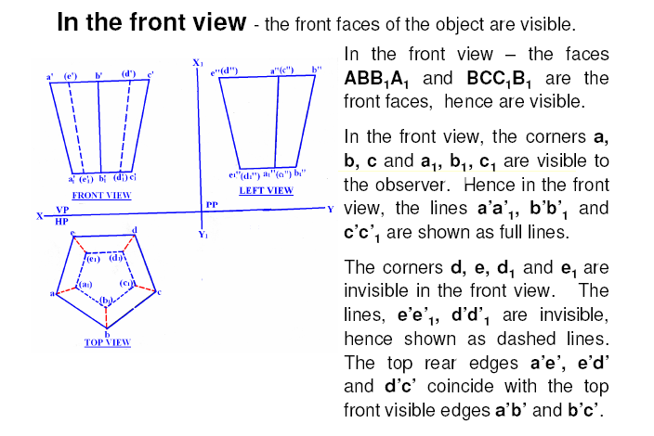

Slide 14
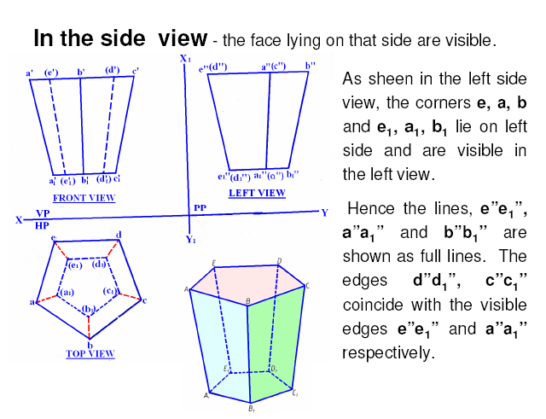

Slide 15
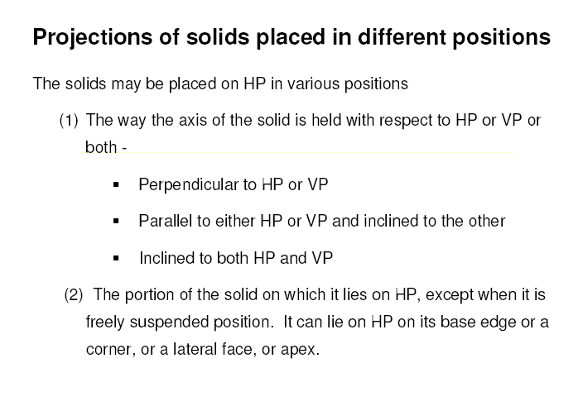

Slide 16
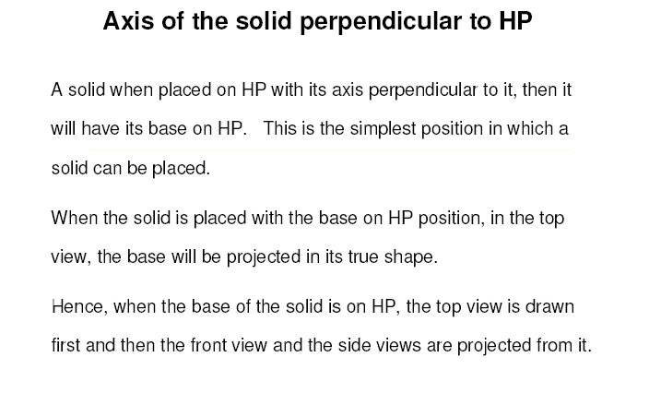

Slide 17
CONE
STANDING ON HP
On its base.
RESTING ON HP
On one point of base circle.
LYING ON HP
On one generator.
(Axis perpendicular to HP
And // to VP)
(Axis inclined to HP
And // to VP)
(Axis inclined to HP
And // to VP)
F.V.
F.V.
F.V.
X
Y
While observing FV, X-Y line represents Horizontal Plane (HP)
X
While observing TV, X-Y line represents Vertical Plane (VP)
Y
T.V.
T.V.
T.V.
STANDING ON VP
On its base.
RESTING ON VP
On one point of base circle.
LYING ON VP
On one generator.
Axis perpendicular to VP
And // to HP
Axis inclined to VP
And // to HP
Axis inclined to VP
And // to HP

Slide 18
While observing the FV, the XY line represents the HP
While observing the TV, the XY line represents the VP.

Slide 19
STEPS TO SOLVE PROBLEMS IN SOLIDS
Problem is solved in three steps:
STEP 1: ASSUME SOLID STANDING ON THE PLANE WITH WHICH IT IS MAKING INCLINATION.
( IF IT IS INCLINED TO HP, ASSUME IT STANDING ON HP)
( IF IT IS INCLINED TO VP, ASSUME IT STANDING ON VP)
IF STANDING ON HP - IT’S TV WILL BE TRUE SHAPE OF IT’S BASE OR TOP:
IF STANDING ON VP - IT’S FV WILL BE TRUE SHAPE OF IT’S BASE OR TOP.
BEGIN WITH THIS VIEW:
IT’S OTHER VIEW WILL BE A RECTANGLE ( IF SOLID IS CYLINDER OR ONE OF THE PRISMS):
IT’S OTHER VIEW WILL BE A TRIANGLE ( IF SOLID IS CONE OR ONE OF THE PYRAMIDS):
DRAW FV & TV OF THAT SOLID IN STANDING POSITION:
STEP 2: CONSIDERING SOLID’S INCLINATION ( AXIS POSITION ) DRAW ITS FV & TV.
STEP 3: IN LAST STEP, CONSIDERING REMAINING INCLINATION, DRAW ITS FINAL FV & TV.
GENERAL PATTERN ( THREE STEPS ) OF SOLUTION:
GROUP B SOLID.
CONE
GROUP A SOLID.
CYLINDER
GROUP B SOLID.
CONE
GROUP A SOLID.
CYLINDER
AXIS
INCLINED HP
AXIS
INCLINED HP
AXIS
VERTICAL
AXIS
INCLINED HP
AXIS
VERTICAL
AXIS
INCLINED HP
AXIS
INCLINED VP
er
AXIS
INCLINED
VP
er
AXIS
INCLINED
VP
AXIS
INCLINED VP
AXIS TO VP
AXIS TO VP
Three steps
If solid is inclined to Hp
Three steps
If solid is inclined to Hp
Three steps
If solid is inclined to Vp
Three steps
If solid is inclined to Vp

Slide 20
Problem 1. A cone with 60 mm diameter base and 60 mm height is resting on HP on one of its generators. Draw its projections if its axis is parallel to the VP.
O’
O’
60
X
1’
2’, 8’
3’, 7’
4’, 6’
5’
Y
7
7₁
8
6
6₁
1’
8₁
3’, 7’
5’
2’, 8’
4’, 6’
O
1₁
1
5
5₁
O₁
Φ60
2
4
4₁
2₁
3
3₁
Step1: Assume cone is resting on its base on HP
Step2: Tilt cone about its corner

Slide 21
Pyramid: Axis inclined to the HP and parallel to the VP
o’
o₁’
Hexagonal pyramid resting on one of its edges on HP
f₁’(a₁’)
e₁’(b₁’)
X
d₁’(c₁’)
Y
f’(a’)
e’(b’)
d’(c’)
b₁
b
a
c
a₁
Axis is inclined at θ to HP
c₁
o
o
d₁
d
f₁
f
e₁
e

Slide 22
In proj of planes question , generally the side which is assumed to be resting on HP is the AF, and in projn of solids, the side assumed is CD
b
a
c
o
d
f
e

Slide 23
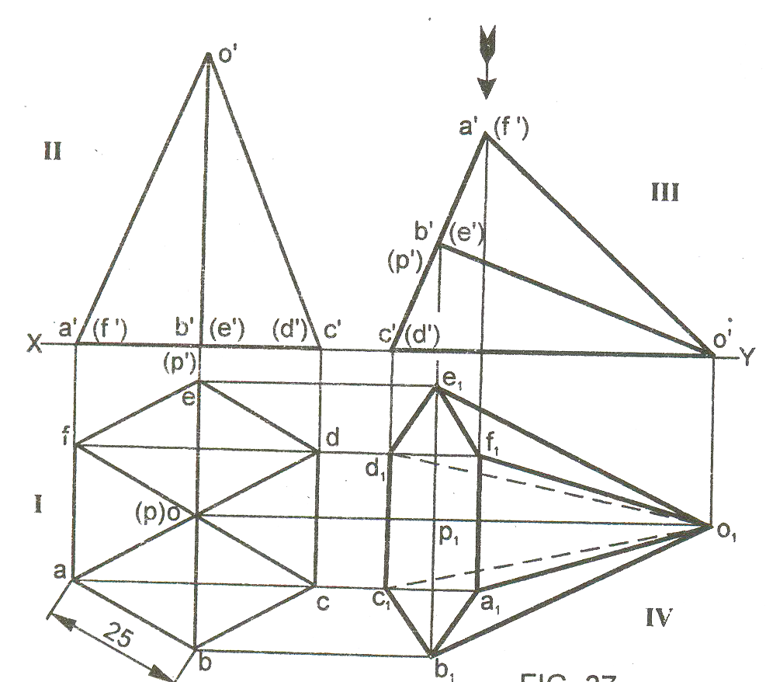
Axis inclined to the HP and parallel to the VP
Resting on one of its slanted face

Slide 24
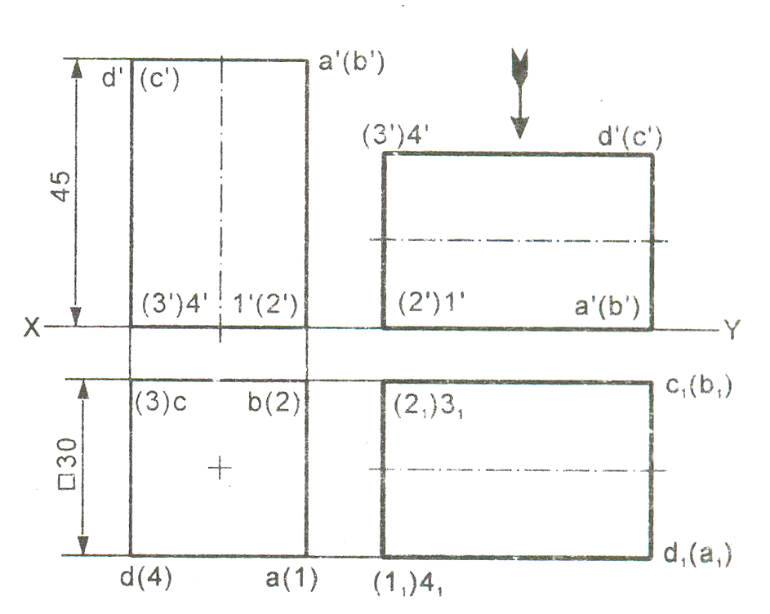
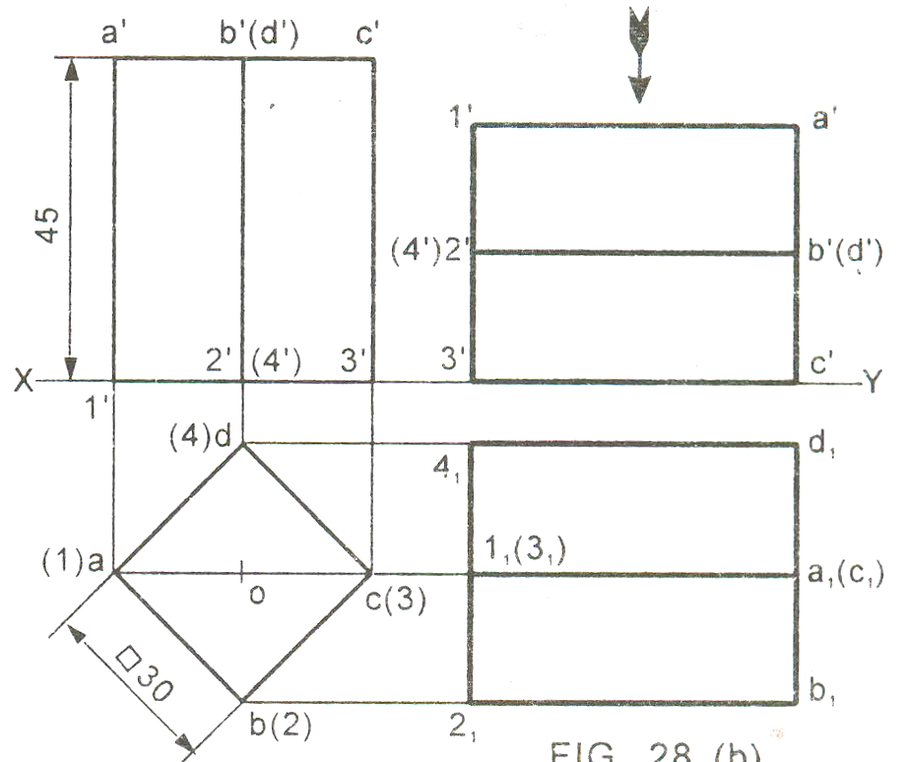
Rectangular faces are equally
inclined to VP and HP
One face parallel to VP
Square Prism
Axis parallel to HP and VP

Slide 25
Problem 2. Pentagonal Prism : Axis inclined to HP and parallel to VP
Pentagonal base is inclined at 30º to HP
a₁’
b₁’(e₁’)
a’
b’(e’)
c’(d’)
Resting on HP with one of its edges perpendicular to VP
c₁’(d₁’)
1₁’
30
X
2₁’(5₁’)
Y
1’
2’(5’)
3’(4’)
3₁’(4₁’)
5₁
e₁
e(5)
d(4)
d₁
4₁
1₁
a₁
a(1)
3₁
c(3)
c₁
b(2)
2₁
b₁

Slide 26
Problem 3. A tetrahedron with edge length 40 mm is resting on HP with its base.
one of it base edges is perpendicular to VP and its base is making 30⁰ with HP. Draw its
projection.
o’
O₁’
Edge length: 40mm
Resting on HP
One of its base edges is perpendicular to HP
Base is inclined at 30º
40
c₁’
c’
a’(b’)
X
Y
a₁’(b₁’)
b
b₁
o
o₁
c
c₁
40
a
a₁

Slide 27
Problem 4. A hexagonal prism of side of base 25 mm and length of axis 70 mm is resting on HP on one of its rectangular faces. Draw its projections when its axis is inclined to VP at 45º.
e’
e1’
25
d’
d1’
e1’
d1’
e’
d’
f’
f1’
c’
c1’
f1’
c1’
f’
c’
a’
a1’
b’
b1’
X
a1’
b1’
a’
b’
Y
f1
a1
e1
b1
d1
c1
45
f1
a1
e1
b1
d1
c1
70
a
e
b
d
a
e
b
d
c
f
c
f
Assume the prism is resting on VP on its base and its axis is perpendicular to VP
True hexagonal face can be visible in front view.
Decide orientation of hexagonal face

Slide 28
Problem 5. A square pyramid, 40 mm base sides and axis 60 mm long, has a triangular face on the ground and the TV makes an angle of 45⁰ with the VP. Draw its projections. Take apex nearer to VP
Solution Steps :
Triangular face on Hp , means it is lying on Hp:
1.Assume it standing on Hp.
2.It’s Tv will show True Shape of base( square)
3.Draw square of 40mm sides with one side vertical Tv &
taking 50 mm axis project Fv. ( a triangle)
4.Name all points as shown in illustration.
5.Draw 2nd Fv in lying position I.e.o’c’d’ face on xy. And project it’s Tv.
6.Make visible lines dark and hidden dotted, as per the procedure.
7.Then construct remaining inclination with Vp
( Vp containing axis ic the center line of 2nd Tv.Make it 45⁰ to xy as
shown take apex near to xy, as it is nearer to Vp) & project final Fv.
o’
a’₁
b’₁
o’
a’
Y
X
b’
c’
d’
d’₁
c’₁
o’₁
d₁
a
d
d₁
a’
a₁
a₁
b’
c’
d’
d₁
o₁
a₁
o
o₁
c₁
b₁
o₁
b
c
c₁
b₁
(APEX
NEARER
TO V.P).
c₁
b₁
(APEX
AWAY
FROM V.P.)
For dark and dotted lines
1.Draw proper outline of new view DARK. 2. Decide direction of an observer.
3. Select nearest point to observer and draw all lines starting from it-dark.
4. Select farthest point to observer and draw all lines (remaining)from it- dotted.
Notes:
Very imp imp imp!!!!!!!!!!!!!!!

Slide 29
Problem 6:
A cylinder 40 mm diameter and 50 mm axis is resting on one point of a base circle on Vp while it’s axis makes 45⁰ with Vp and Fv of the axis 35⁰ with Hp. Draw projections..
Solution Steps:
Resting on Vp on one point of base, means inclined to Vp:
1.Assume it standing on Vp
2.It’s Fv will show True Shape of base & top( circle )
3.Draw 40mm dia. Circle as Fv & taking 50 mm axis project Tv.
( a Rectangle)
4.Name all points as shown in illustration.
5.Draw 2nd Tv making axis 45⁰ to xy And project it’s Fv above xy.
6.Make visible lines dark and hidden dotted, as per the procedure.
7.Then construct remaining inclination with Hp
( Fv of axis I.e. center line of view to xy as shown) & project final Tv.
d’
d’
d’
4’
4’
4’
3’
c’
a’
c’
1’
3’
a’
c’
3’
1’
a’
1’
X
2’
b’
b’
b’
2’
a b d c
2’
35⁰
Y
45⁰
c₁
a b d c
d₁
b₁
a₁
3
1 2 4 3
4
1 2 4 3
2
1

Slide 30
Problem 7:A tetrahedron of 50 mm long edges is resting on one edge on Hp while one triangular face containing this edge is vertical and 45⁰ inclined to Vp. Draw projections.
Solution Steps
As it is resting assume it standing on Hp.
Begin with Tv , an equilateral triangle as side case as shown:
First project base points of Fv on xy, name those & axis line.
From a’ with TL of edge, 50 mm, cut on axis line & mark o’
(as axis is not known, o’ is finalized by slant edge length)
Then complete Fv.
In 2nd Fv make face o’b’c’ vertical as said in problem.
And like all previous problems solve completely.
IMPORTANT:
Tetrahedron is a
special type
of triangular
pyramid in which
base sides &
slant edges are
equal in length.
Solid of four faces.
Like cube it is also
described by One
dimension only..
Axis length
generally not given.
o’₁
o’
o’
T L
a’
a’₁
90⁰
X
a’
b’
b’
c’
b’₁
c’
c’₁
Y
45⁰
c
c₁
c₁
a
o
o₁
a₁
o₁
b₁
b
b₁
a₁
Notes:
There is a error in the third FV given. The correct figure should have a1’b1’ visible and c1’o1’ hidden.

Slide 31
Problem 8: A right circular cone,
40 mm base diameter and 60 mm
long axis is resting on Hp on one
point of base circle such that it’s
axis makes 45⁰ inclination with
Hp and 40⁰ inclination with Vp.
Draw it’s projections.
In previous all cases 2nd inclination was done by a parameter not showing TL. Like
Tv of axis is inclined to Vp etc. But here it is clearly said that the axis is 40⁰ inclined
to Vp. Means here TL inclination is expected. So the same construction done in those
Problems is done here also. See carefully the final Tv and inclination taken there.
So assuming it standing on HP begin as usual.
o’
o’₁
a’
h’b’
c’g’
d’f’
e’
a’₁
h’₁
b’₁
o’
g’₁
c’₁
45⁰
f’₁
d’₁
y
X
a’
h’
b’
c’
g’
f’
d’
e’
e’₁
Axis True Length
g
g₁
o₁
40⁰
h
f
h₁
f₁
a
Axis Tv Length
d₁
c₁
e
a₁
1
e₁
o₁
e₁
f₁
Locus of
Center 1
b₁
d₁
1
b₁
b
d
c
c₁
g₁
a₁
Axis Tv Length
h₁

Slide 32
FREELY SUSPENDED SOLIDS:
Positions of CG on the axis from the base and for different solids are shown below.
H
CG
H/2
CG
H/4
GROUP A SOLIDS
( Cylinder & Prisms)
GROUP B SOLIDS
( Cone & Pyramids)

Slide 33
Pyramid Suspended from Corner
Problem – 9: A square pyramid with its base equally inclined to VP has a side of 32 mm and length of axis 60 mm is suspended from one of its corners. Draw its projections.
a1’
o’
b1’
d1’
0.25×60 = 15
g1’
60
g’
c1’
o1’
X
Y
a’
b’, d’
c’
d1
d
1
a1
g1
o1
a
o
c
c1
32
b
b1

Slide 34
Solution Steps:
In all suspended cases axis shows inclination with Hp.
1.Hence assuming it standing on Hp, draw Tv - a regular pentagon,corner case.
2.Project Fv & locate CG position on axis – ( ¼ H from base.) and name g’ and
Join it with corner d’
3.As 2nd Fv, redraw first keeping line g’d’ vertical.
4.As usual project corresponding Tv and then Side View looking from.
Problem 10: A pentagonal pyramid
30 mm base sides & 60 mm long axis,
is freely suspended from one corner of
base so that a plane containing it’s axis
remains parallel to Vp.
Draw it’s three views.
LINE d’g’ VERTICAL
d”
o’
d’
c’
e’
e”
c”
H
FOR SIDE VIEW
g’
a’
b’
a”
b”
g’
IMPORTANT:
When a solid is freely
suspended from a
corner, then line joining point of contact & C.G. remains vertical.
( Here axis shows inclination with Hp.)
So in all such cases, assume solid standing on Hp initially.)
H/4
o”
Y
b’
e’
X
a’
c’
d’
e
e₁
a
a₁
o
d
d₁
o₁
b
b₁
c
c₁
Notes:
Note that in any of the questions in the projection of solids, if the axis is inclined to HP, then always rotate the first FV clockwise to get the second front view.

Slide 35
In all the suspended cases, the line joining the point of suspension and the CG of the solid always remains vertical with the CG below the point of suspension on the vertical line.

Slide 36

Thank You for Patient Hearing
Notes:
If the base is pentagon and suppose an edge rests on HP, then draw the pentagon such that the edge is on the right most and perpendicular to XY line.
But if it rests on a point on the HP, then draw the pentagon such that the point is on the right most and the left most edge is perpendicular to XY line.
And in all the suspended cases , draw using the point case.

